Slide 1
How to Take your Data from Messy to Tidy
R-Ladies STL
9/22/2020

Slide 2

Hello world! My name is Erin
Data Scientist at Uncommon Schools
Link to slides:
https://github.com/eringrand/RLadies-STL-Cleaning-Data-Workshop
Requirements for today:
Open Rstudio
Download Notebooks and Data from the Github link
Install “tidyverse” and “janitor” packages
Twitter: @astroeringand
Github: eringrand
Blog: https://eringrand.github.io

Slide 3
"Tidy data sets are all alike; but every messy data set is messy in its own way."
- Hadley Wickham

Slide 4
Janitor

Slide 5

Janitor was built with beginning-to-intermediate R users in mind and is optimized for user-friendliness. Advanced users can already do everything covered here, but they can do it faster with janitor and save their thinking for more fun tasks. (Sam Firke)
You should be able to do everything inside janitor on your own, but we don’t have the time to always clean up data without help.

Slide 6
Two Important Functions
clean_names(data)
get_dupes(data, …)

Slide 7
clean_names()

Slide 8
clean_names – why?

Slide 9
Cleaning an Excel Sheet
students <- read_excel(filepath, sheet="Sheet1", col_types = "text") %>%
janitor::clean_names() %>%
janitor::remove_empty(c(“cols”, “rows”)) %>% mutate_at(vars(entry_date, exit_date, student_id, years_in_uncommon), as.numeric) %>%
mutate_at(vars(entry_date, exit_date), janitor::excel_numeric_to_date)

Slide 10
get_dupes()

Slide 11
get_dupes - example
data %>% get_dupes(…)
Names of columns to check for duplicates
Data frame with duplicates

Slide 12
get_dupes – example with student roster
students %>% get_dupes(student_id)
Names of columns to check for duplicates
Data frame with duplicates
# A tibble: 2 x 6
student_id dupe_count grade yearsinuncommon entry_date exit_date
<dbl> <int> <dbl> <dbl> <date> <date>
1 7851976 2 5 1 2017-11-12 2017-12-12
2 7851976 2 6 1 2017-11-12 2017-12-12

Slide 13
Practice – what does get_dupes do?
select
arrange
filter
mutate
group_by
summarize

Slide 14
Answer
students %>%
group_by(student_id) %>%
mutate(dupe_count = n() ) %>%
filter(dupe_count > 1) %>%
select(student_id, dupe_count, everything() )
group_by columns to check for duplicates
mutate
Count the # of rows in each “group”
filter
Keep only rows that have duplicates
select
Reorder the columns

Slide 15
Correcting Duplicates
Version 1. Correct the dupes individually with if_else or case_when
students %>%
mutate(grade = if_else(student_id == 7851976, 5, grade)) %>%
distinct()
Version 2. Simplify the data by summarizing the min or max of the duplicate causing column
students %>%
group_by(student_id) %>%
summarize(grade = min(grade))
Version 3. Output the duplicates and manually choose which version to keep
dupes_remove <- read_csv("dupes_correct.csv") %>%
filter(del == 1)
anti_join(students, dupes_remove)

Slide 16
Your Turn– Duplicates
Find duplicates in the practice sat exam set.
Look at the data set. What do you see? What do you think this data is? What is this data unique by?
What is the student identifier in this data?
What other columns do you need to include in your dupes check?
What business rules should you ask about when correcting duplicates?

Slide 17
Tidy Data with tidyr()

Slide 18
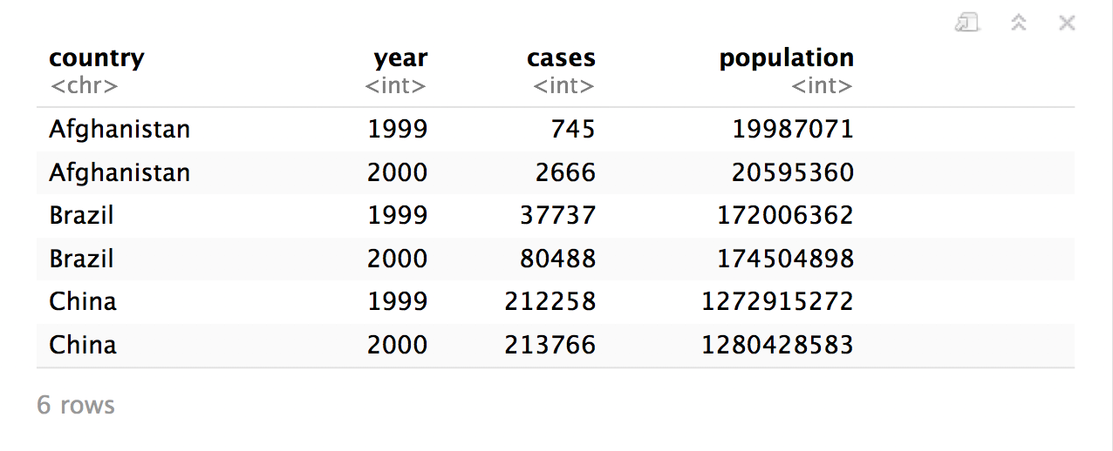
Quiz
What are the variables in this data set?
table1

Slide 19
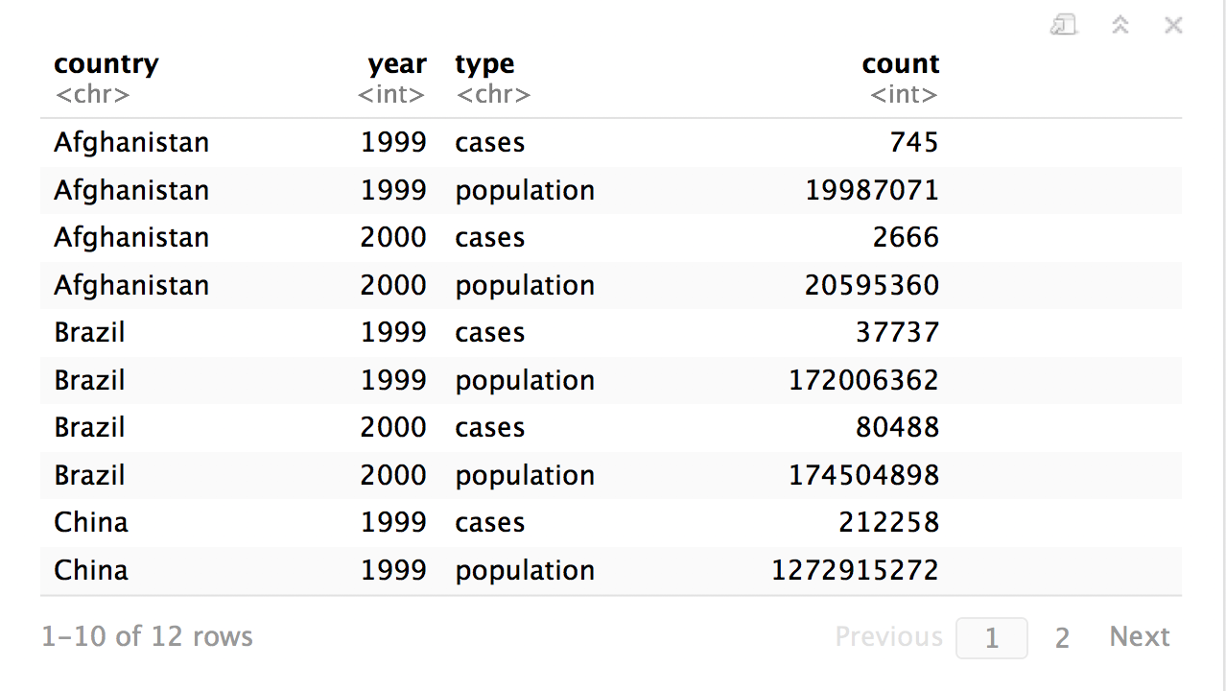
Quiz
What are the variables in this data set?
table2

Slide 20
Tidy Data
country | year | cases | pop
Afghanistan | 1999 | 745 | 19987071
Afghanistan | 2000 | 2666 | 20595360
Brazil | 1999 | 37737 | 172006362
Brazil | 2000 | 80488 | 174504898
China | 1999 | 212258 | 1272915272
China | 2000 | 213766 | 1280428583
A data set is tidy iff:
Each variable is in its own column
Each case is in its own row
Each value is in its own cell

Slide 21
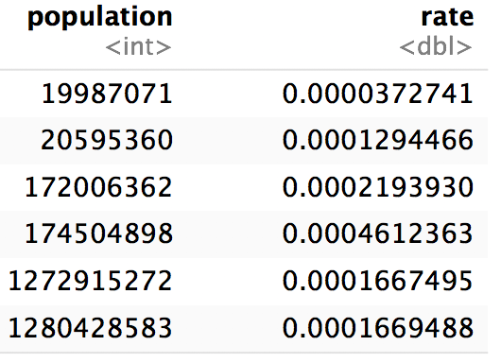
Tidy Data is easy to manipulate

Slide 22
pivot_longer()

Slide 23
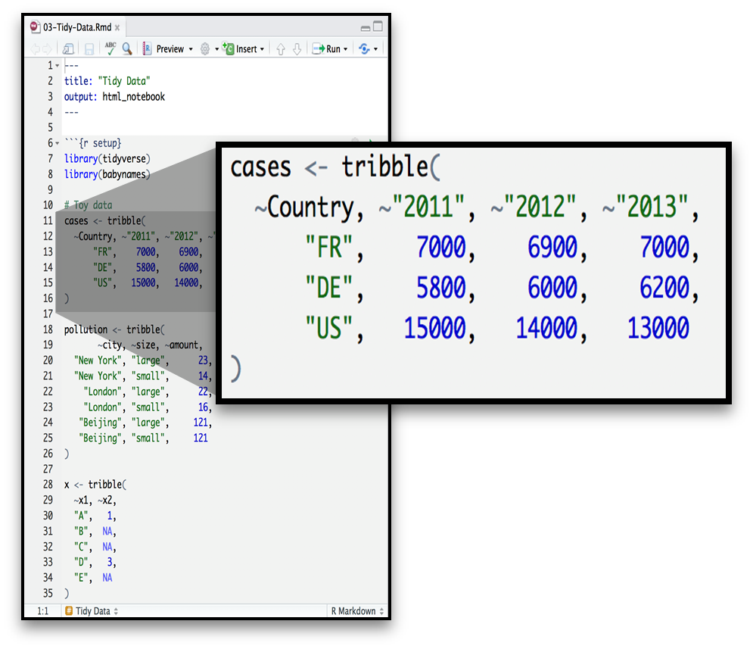
Toy Data - Wide

Slide 24
Your Turn
On a sheet of paper, draw how the cases data set would look if it had the same values_from grouped into three columns: country, year, n
Country | 2011 | 2012 | 2013
FR | 7000 | 6900 | 7000
DE | 5800 | 6000 | 6200
US | 15000 | 14000 | 13000

Slide 25
Country | 2011 | 2012 | 2013
FR | 7000 | 6900 | 7000
DE | 5800 | 6000 | 6200
US | 15000 | 14000 | 13000

Slide 26
Country | 2011 | 2012 | 2013
FR | 7000 | 6900 | 7000
DE | 5800 | 6000 | 6200
US | 15000 | 14000 | 13000
Country | Year | n
FR | 2011 | 7000
DE | 2011 | 5800
US | 2011 | 15000
FR | 2012 | 6900
DE | 2012 | 6000
US | 2012 | 14000
FR | 2013 | 7000
DE | 2013 | 6200
US | 2013 | 13000

Slide 27
Country | 2011 | 2012 | 2013
FR | 7000 | 6900 | 7000
DE | 5800 | 6000 | 6200
US | 15000 | 14000 | 13000
Country | Year | n
FR | 2011 | 7000
DE | 2011 | 5800
US | 2011 | 15000
FR | 2012 | 6900
DE | 2012 | 6000
US | 2012 | 14000
FR | 2013 | 7000
DE | 2013 | 6200
US | 2013 | 13000

Slide 28
Country | 2011 | 2012 | 2013
FR | 7000 | 6900 | 7000
DE | 5800 | 6000 | 6200
US | 15000 | 14000 | 13000
Country | Year | n
FR | 2011 | 7000
DE | 2011 | 5800
US | 2011 | 15000
FR | 2012 | 6900
DE | 2012 | 6000
US | 2012 | 14000
FR | 2013 | 7000
DE | 2013 | 6200
US | 2013 | 13000

Slide 29
Country | 2011 | 2012 | 2013
FR | 7000 | 6900 | 7000
DE | 5800 | 6000 | 6200
US | 15000 | 14000 | 13000
Country | Year | n
FR | 2011 | 7000
DE | 2011 | 5800
US | 2011 | 15000
FR | 2012 | 6900
DE | 2012 | 6000
US | 2012 | 14000
FR | 2013 | 7000
DE | 2013 | 6200
US | 2013 | 13000

Slide 30
Country | 2011 | 2012 | 2013
FR | 7000 | 6900 | 7000
DE | 5800 | 6000 | 6200
US | 15000 | 14000 | 13000
Country | Year | n
FR | 2011 | 7000
DE | 2011 | 5800
US | 2011 | 15000
FR | 2012 | 6900
DE | 2012 | 6000
US | 2012 | 14000
FR | 2013 | 7000
DE | 2013 | 6200
US | 2013 | 13000

Slide 31
Country | 2011 | 2012 | 2013
FR | 7000 | 6900 | 7000
DE | 5800 | 6000 | 6200
US | 15000 | 14000 | 13000
Country | Year | n
FR | 2011 | 7000
DE | 2011 | 5800
US | 2011 | 15000
FR | 2012 | 6900
DE | 2012 | 6000
US | 2012 | 14000
FR | 2013 | 7000
DE | 2013 | 6200
US | 2013 | 13000

Slide 32
Country | 2011 | 2012 | 2013
FR | 7000 | 6900 | 7000
DE | 5800 | 6000 | 6200
US | 15000 | 14000 | 13000
Country | Year | n
FR | 2011 | 7000
DE | 2011 | 5800
US | 2011 | 15000
FR | 2012 | 6900
DE | 2012 | 6000
US | 2012 | 14000
FR | 2013 | 7000
DE | 2013 | 6200
US | 2013 | 13000

Slide 33
Final Answers – pivot_longer() practice
Country | 2011 | 2012 | 2013
FR | 7000 | 6900 | 7000
DE | 5800 | 6000 | 6200
US | 15000 | 14000 | 13000
Country | Year | n
FR | 2011 | 7000
DE | 2011 | 5800
US | 2011 | 15000
FR | 2012 | 6900
DE | 2012 | 6000
US | 2012 | 14000
FR | 2013 | 7000
DE | 2013 | 6200
US | 2013 | 13000

Slide 34
Country | 2011 | 2012 | 2013
FR | 7000 | 6900 | 7000
DE | 5800 | 6000 | 6200
US | 15000 | 14000 | 13000
Country | Year | n
FR | 2011 | 7000
DE | 2011 | 5800
US | 2011 | 15000
FR | 2012 | 6900
DE | 2012 | 6000
US | 2012 | 14000
FR | 2013 | 7000
DE | 2013 | 6200
US | 2013 | 13000
Country | Year | n
FR | 2011 | 7000
DE | 2011 | 5800
US | 2011 | 15000
FR | 2012 | 6900
DE | 2012 | 6000
US | 2012 | 14000
FR | 2013 | 7000
DE | 2013 | 6200
US | 2013 | 13000

Slide 35
Country | 2011 | 2012 | 2013
FR | 7000 | 6900 | 7000
DE | 5800 | 6000 | 6200
US | 15000 | 14000 | 13000
Country | Year | n
FR | 2011 | 7000
DE | 2011 | 5800
US | 2011 | 15000
FR | 2012 | 6900
DE | 2012 | 6000
US | 2012 | 14000
FR | 2013 | 7000
DE | 2013 | 6200
US | 2013 | 13000
pivot_longer

Slide 36
former column names
Country | 2011 | 2012 | 2013
FR | 7000 | 6900 | 7000
DE | 5800 | 6000 | 6200
US | 15000 | 14000 | 13000
Country | Year | n
FR | 2011 | 7000
DE | 2011 | 5800
US | 2011 | 15000
FR | 2012 | 6900
DE | 2012 | 6000
US | 2012 | 14000
FR | 2013 | 7000
DE | 2013 | 6200
US | 2013 | 13000
Country | Year | n
FR | 2011 | 7000
DE | 2011 | 5800
US | 2011 | 15000
FR | 2012 | 6900
DE | 2012 | 6000
US | 2012 | 14000
FR | 2013 | 7000
DE | 2013 | 6200
US | 2013 | 13000

Slide 37
name_to values_from_to
Country | 2011 | 2012 | 2013
FR | 7000 | 6900 | 7000
DE | 5800 | 6000 | 6200
US | 15000 | 14000 | 13000
Country | Year | n
FR | 2011 | 7000
DE | 2011 | 5800
US | 2011 | 15000
FR | 2012 | 6900
DE | 2012 | 6000
US | 2012 | 14000
FR | 2013 | 7000
DE | 2013 | 6200
US | 2013 | 13000
Country | Year | n
FR | 2011 | 7000
DE | 2011 | 5800
US | 2011 | 15000
FR | 2012 | 6900
DE | 2012 | 6000
US | 2012 | 14000
FR | 2013 | 7000
DE | 2013 | 6200
US | 2013 | 13000

Slide 38
pivot_longer()
cases %>%
pivot_longer(2:4, names_to = “year”, values_to = “n”)
data frame to reshape
numeric indexes of columns to collapse
(or names)
name of the new column
(a character string)
name of the new value column
(a character string)
Country | 2011 | 2012 | 2013
FR | 7000 | 6900 | 7000
DE | 5800 | 6000 | 6200
US | 15000 | 14000 | 13000

Slide 39
pivot_longer()
cases %>%
pivot_longer(`2011`:`2013`, names_to = “year”, values_to = “n”)
data frame to reshape
Names of columns to collapse
name of the new column
(a character string)
name of the new value column
(a character string)
Country | 2011 | 2012 | 2013
FR | 7000 | 6900 | 7000
DE | 5800 | 6000 | 6200
US | 15000 | 14000 | 13000

Slide 40
pivot_longer()
cases %>%
pivot_longer(-Country, names_to = “year”, values_to = “n”)
data frame to reshape
Names of columns to collapse
name of the new column
(a character string)
name of the new value column
(a character string)
Country | 2011 | 2012 | 2013
FR | 7000 | 6900 | 7000
DE | 5800 | 6000 | 6200
US | 15000 | 14000 | 13000

Slide 41
pivot_longer() - examples
cases %>% pivot_longer(2:4, names_to = “year”, values_to = “n”)
cases %>%
pivot_longer(`2011`:`2013`, names_to = “year”, values_to = “n”)
cases %>%
pivot_longer(-Country, names_to = “year”, values_to = “n”)

Slide 42
Check for Understanding
(Select All) Which of these will create tidy data?
cases %>% clean_names() %>% select(country, year, n)
cases %>% pivot_longer(Country, names_to = “year”, values_to = “n”)
cases %>% pivot_longer(-Country, names_to=“year”, values_to=“values”)
babynames

Slide 43
Check for Understanding
(Select All) Which of these will create tidy data?
cases %>% clean_names() %>% select(country, year, n)
cases %>% pivot_longer(Country, names_to = “year”, values_to = “n”)
cases %>% pivot_longer(-Country, names_to=“year”, values_to=“values”)
babynames

Slide 44
pivot_wider()

Slide 45
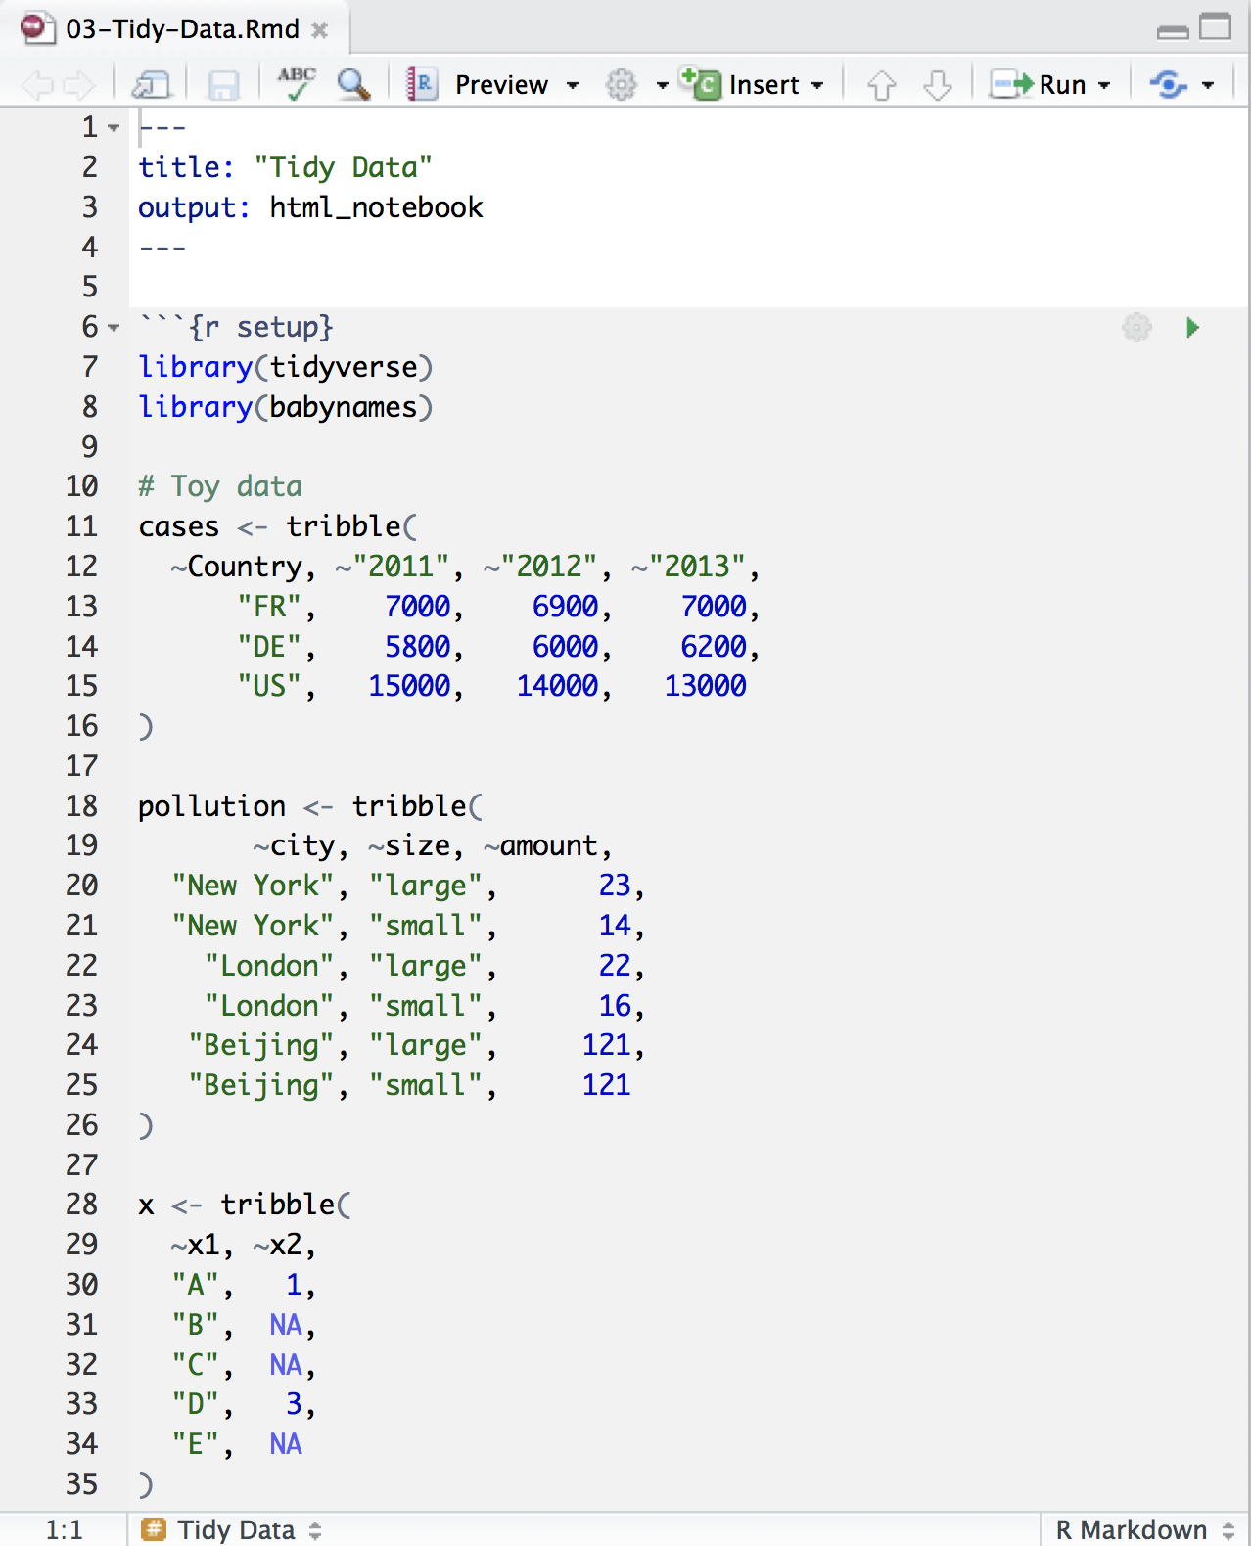
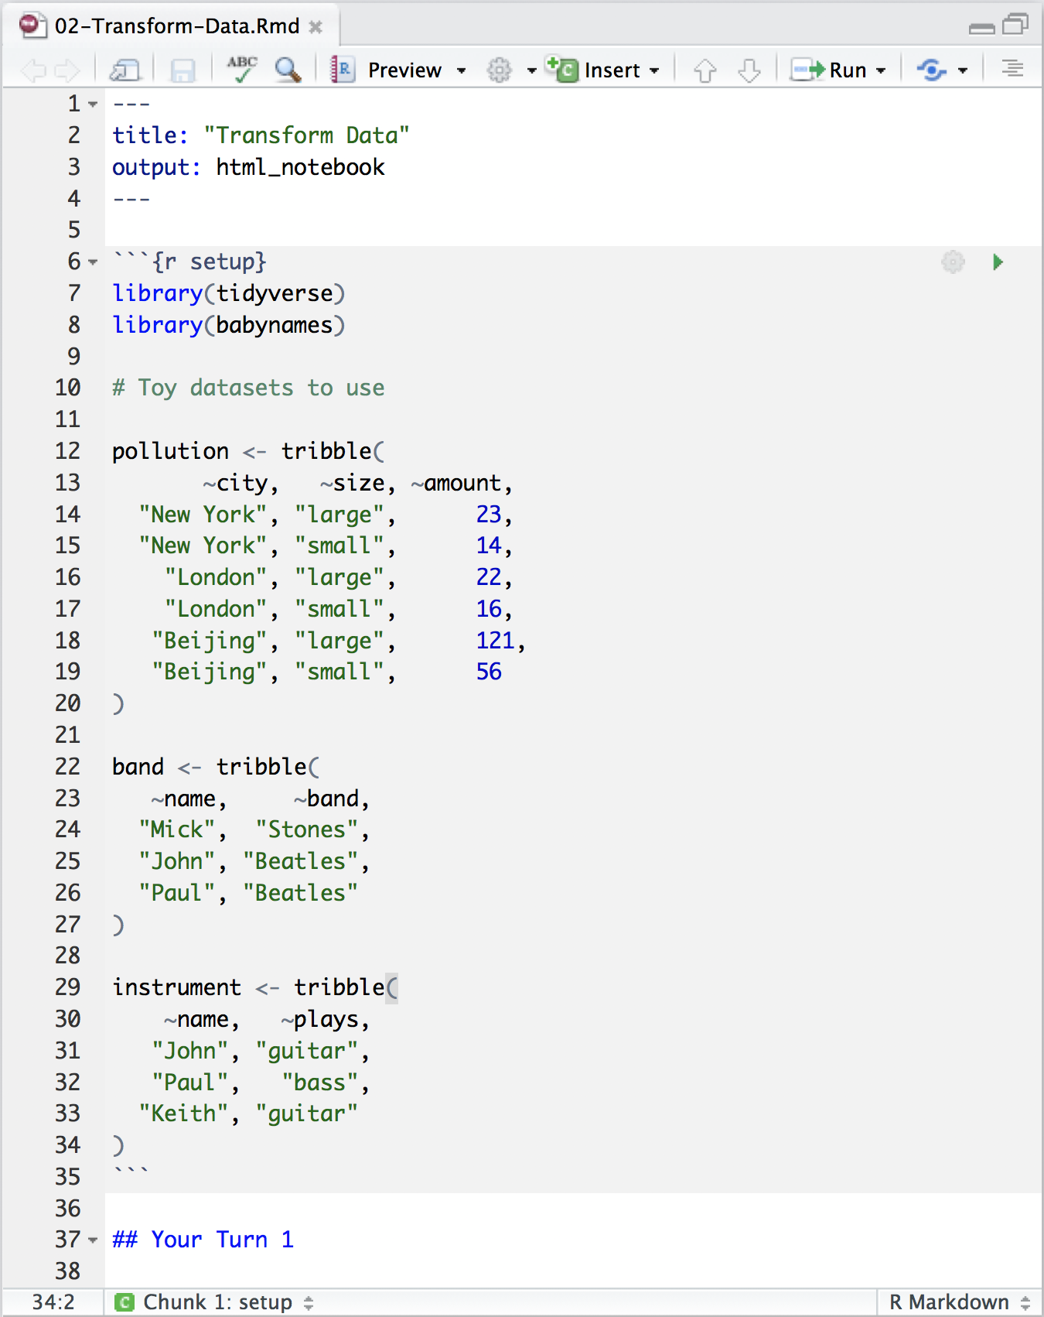
Toy Data

Slide 46
Quiz
What are the variables in the pollution data set?
city | particle size | amount (µg/m³)
New York | large | 23
New York | small | 14
London | large | 22
London | small | 16
Beijing | large | 121
Beijing | small | 56

Slide 47
Quiz
What are the variables in the pollution data set?
city | particle size | amount (µg/m³)
New York | large | 23
New York | small | 14
London | large | 22
London | small | 16
Beijing | large | 121
Beijing | small | 56

Slide 48
Your Turn
On a sheet of paper, draw how the pollution data set would look if it had the same values grouped into three columns: city, large, small
city | particle size | amount (µg/m³)
New York | large | 23
New York | small | 14
London | large | 22
London | small | 16
Beijing | large | 121
Beijing | small | 56

Slide 49
city | size | amount
New York | large | 23
New York | small | 14
London | large | 22
London | small | 16
Beijing | large | 121
Beijing | small | 56

Slide 50
city | size | amount
New York | large | 23
New York | small | 14
London | large | 22
London | small | 16
Beijing | large | 121
Beijing | small | 56
city | large | small
New York | 23 | 14
London | 22 | 16
Beijing | 121 | 56

Slide 51
city | size | amount
New York | large | 23
New York | small | 14
London | large | 22
London | small | 16
Beijing | large | 121
Beijing | small | 56
city | large | small
New York | 23 | 14
London | 22 | 16
Beijing | 121 | 56

Slide 52
city | size | amount
New York | large | 23
New York | small | 14
London | large | 22
London | small | 16
Beijing | large | 121
Beijing | small | 56
city | large | small
New York | 23 | 14
London | 22 | 16
Beijing | 121 | 56

Slide 53
city | size | amount
New York | large | 23
New York | small | 14
London | large | 22
London | small | 16
Beijing | large | 121
Beijing | small | 56
city | large | small
New York | 23 | 14
London | 22 | 16
Beijing | 121 | 56

Slide 54
city | size | amount
New York | large | 23
New York | small | 14
London | large | 22
London | small | 16
Beijing | large | 121
Beijing | small | 56
city | large | small
New York | 23 | 14
London | 22 | 16
Beijing | 121 | 56

Slide 55
city | size | amount
New York | large | 23
New York | small | 14
London | large | 22
London | small | 16
Beijing | large | 121
Beijing | small | 56
city | large | small
New York | 23 | 14
London | 22 | 16
Beijing | 121 | 56

Slide 56
city | size | amount
New York | large | 23
New York | small | 14
London | large | 22
London | small | 16
Beijing | large | 121
Beijing | small | 56
city | large | small
New York | 23 | 14
London | 22 | 16
Beijing | 121 | 56

Slide 57
city | size | amount
New York | large | 23
New York | small | 14
London | large | 22
London | small | 16
Beijing | large | 121
Beijing | small | 56
city | large | small
New York | 23 | 14
London | 22 | 16
Beijing | 121 | 56

Slide 58
city | size | amount
New York | large | 23
New York | small | 14
London | large | 22
London | small | 16
Beijing | large | 121
Beijing | small | 56
pivot_wider()
city | large | small
New York | 23 | 14
London | 22 | 16
Beijing | 121 | 56

Slide 59
names_from
city | size | amount
New York | large | 23
New York | small | 14
London | large | 22
London | small | 16
Beijing | large | 121
Beijing | small | 56
city | large | small
New York | 23 | 14
London | 22 | 16
Beijing | 121 | 56

Slide 60
names_from
values_from
city | size | amount
New York | large | 23
New York | small | 14
London | large | 22
London | small | 16
Beijing | large | 121
Beijing | small | 56
city | large | small
New York | 23 | 14
London | 22 | 16
Beijing | 121 | 56

Slide 61
pivot_wider()
pollution %>%
pivot_wider(names_from = size,
values_from = amount)
data frame to reshape
column to use for names_from (becomes new
column names)
column to use for values_from
(becomes new
column cells)

Slide 62
pivot_wider Tips and Tricks
Most tidyverse functions are made to work with LONG (tidy) data, so it is often better to wait till near the end of the code to shift to WIDE data if needed for output
Make sure to SELECT all the columns you need before a pivot_wider to remove columns that may cause problems (duplicates)
New change! You CAN pivot_wider more than one column! The pivot_wider help file has information on how to do this,

Slide 63
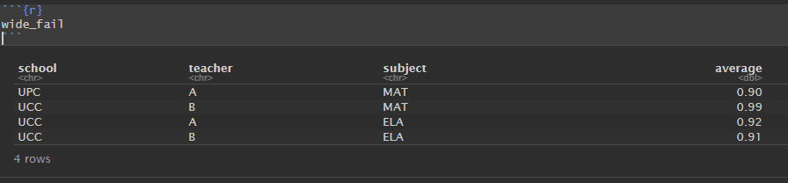
wide_fail
Make sure to SELECT all the columns you need before a pivot_wider to remove columns that may cause problems (duplicates)

Slide 64
wide_fail
Make sure to SELECT all the columns you need before a pivot_wider to remove columns that may cause problems (duplicates)
wide_fail %>%
pivot_wider(names_from = subject,
values_from = average)
school | teacher | ELA | MAT
UCC | A | 0.92 | NA
UCC | B | 0.91 | 0.99
UPC | A | NA | 0.90

Slide 65
wide_fail
Make sure to SELECT all the columns you need before a pivot_wider to remove columns that may cause problems (duplicates)
wide_fail %>%
pivot_wider(names_from = subject,
values_from = average)
school | teacher | ELA | MAT
UCC | A | 0.92 | NA
UCC | B | 0.91 | 0.99
UPC | A | NA | 0.90

Slide 66
Reshaping Final Check

Slide 67
Your Turn
Can we calculate the ratio of boys to girls?
Reshape the layout of this data. Calculate the ratio of male to female) children by year.
babynames %>%
group_by(year, sex) %>%
summarize(n = sum(n))

Slide 68
Your Turn
Can we calculate the ratio of boys to girls?
Reshape the layout of this data. Calculate the ratio of male to females each year.
babynames %>%
group_by(year, sex) %>%
summarize(n = sum(n)) %>%
pivot_wider(names_from = sex, values_from = n) %>%
clean_names() %>%
mutate(ratio = f / m)

